Slide 1
Demand side management and smart metering
Ch=5

Slide 2
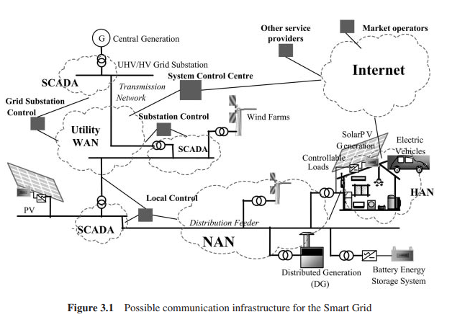

Slide 4
The dual aims of reducing CO2 emissions and improving energy security (energy policy goals in many countries) coincide in the increasing use of renewable energy for electricity generation.
However, connection of a large amount of intermittent renewable generation alters the pattern of the output of central generation and the power flows in both transmission and distribution circuits.
One solution to this increase in variability is to add large-scale energy storage devices to the power system.

Slide 5
This is often not practical at present due to technical limitations and cost. Therefore, flexibility in the demand side is seen as another way to enable the integration of a large amount of renewable energy.
The name Demand-Side Management (DSM) has been used since the 1970s for a systematic way of managing loads
Later on, Demand Response (DR), Demand-Side Response (DSR), Demand-Side Bidding (DSB) and Demand Bidding (DB) were used to describe a range of different demand side initiatives

Slide 6
To avoid the confusion caused by such overlapping concepts and terminologies, as recommended by CIGRE, Demand-Side Integration (DSI) is used.
Effective implementation of DSI needs an advanced ICT (Information and Communication Technology) infrastructure and good knowledge of system loads.
However, the electro-mechanical meters that are presently installed in domestic premises have little or no communication ability and do not transmit information of the load in real time

Slide 7
Smart metering refers to systems that measure, collect, analyze, and manage energy use using advanced ICT.
The concept includes two-way communication networks between smart meters and various actors in the energy supply system.
The smart meter is seen to facilitate DSI through providing real-time or near-real-time information exchange and advanced control capabilities

Slide 8
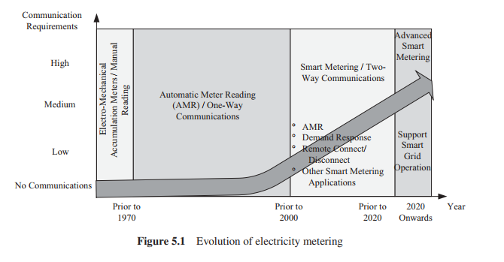
Smart metering

Slide 9
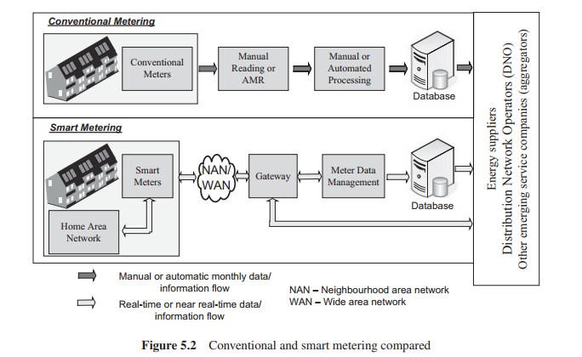

Slide 10
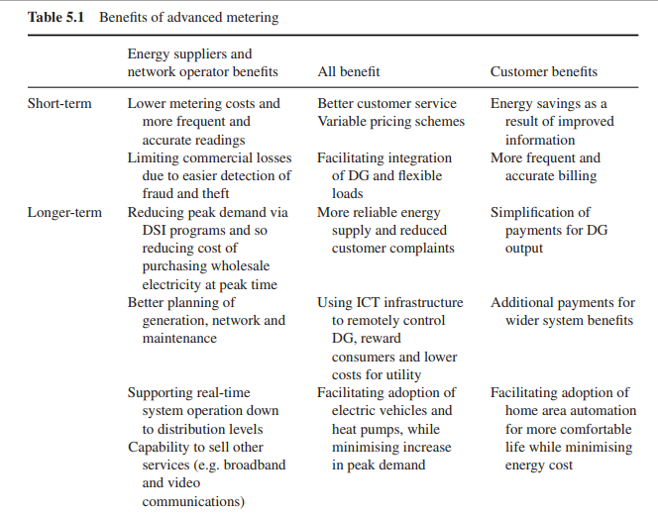

Slide 11
Key components of smart metering
Smart metering consists of four main components:
smart meters,
a two-way communication network,
a Meter Data Management system (MDM),
and HAN

Slide 12
Smart Meter
The replacement of electro-mechanical meters with electronic meters offers several benefits. Electronic meters not only can measure instantaneous power and the amount of energy consumed over time but also other parameters such as power factor, reactive power, voltage and frequency, with high accuracy. Data can be measured and stored at specific intervals

Slide 13
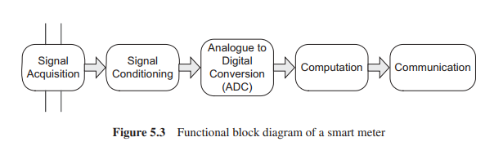

Slide 14
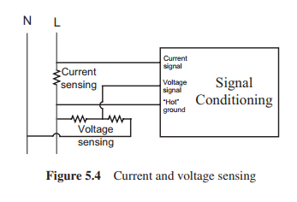
Signal acquisition

Slide 15
The fundamental electrical parameters required are the magnitude and frequency of the voltage and the magnitude and phase displacement (relative to the voltage) of current. Other parameters such as the power factor, the active/reactive power, and Total Harmonic Distortion (THD) are computed using these fundamental quantities.

Slide 16
Signal conditioning:
The signal conditioning stage involves the preparation of the input signals for the next step in the process, ADC. The signal conditioning stage may include addition/subtraction, attenuation/amplification and filtering. When it comes to physical implementation, the signal conditioning stages can be realised as discrete elements or combined with the ADC as part of an Integrated Circuit. Alternatively the stages can be built into a ‘System on a Chip’ architecture with a number of other functions.

Slide 17
In many circumstances the input signal will require attenuation, amplification or the addition/subtraction of an offset such that its maximum magnitude lies within the limits of the inputs for the ADC stage.

Slide 18
To avoid inaccuracy due to aliasing, it is necessary to remove components of the input signal above the Nyquist frequency (that is, half the sampling rate of the ADC). Therefore, prior to input to the ADC stage, a low pass filter is applied to the signal

Slide 19
Analogue to digital conversion
Current and voltage signals obtained from the sensors are first sampled and then digitised to be processed by the metering software. Since there are two signals (current and voltage) in a single phase meter, if a single ADC is used, a multiplexer is required to send the signals in turn to the ADC.

Slide 20
Communications infrastructure and protocols for smart metering
Wide Area Network (WAN),
Neighborhood Area Network(NAN)
and Home Area Network (HAN).

Slide 21
Home-area network
A Home-Area Network (HAN) is an integrated system of smart meter, in-home display, microgeneration, smart appliances, smart sockets, HVAC (Heating, Ventilation, Air Conditioning) facilities and plug-in hybrid/electric vehicles.
A HAN uses wired or wireless communications and networking protocols to ensure the interoperability of networked appliances and the interface to a smart meter. It also includes security mechanisms to protect consumer data and the metering system.

Slide 22
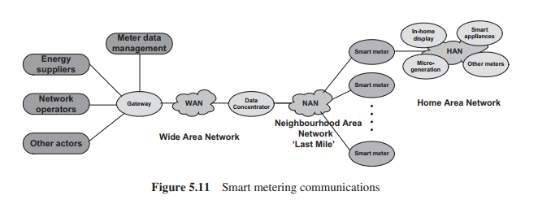

Slide 23
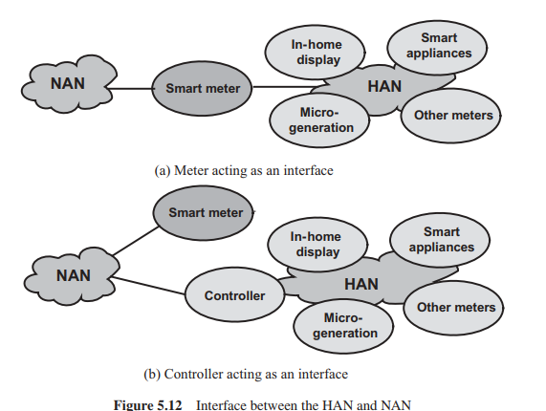

Slide 24
It is expected that HAN will provide benefits to the utilities through demand response and management and the management of micro-generation and the charging of electric vehicles.
In order to provide demand management functions and demand response, two options are being actively considered in different countries.
One option is to use the smart meter as the interface to the suppliers, network operators and other actors. The other option is to use a separate control box [7, 8] which is directly interfaced to the outside world through the NAN and WAN.

Slide 25
Neighbourhood area network:
The primary function of the Neighbourhood Area Network (NAN) is to transfer consumption readings from smart meters. The NAN should also facilitate diagnostic messages, firmware upgrades and real-time or near real-time messages for the power system support.

Slide 26
Data concentrator
The data concentrator acts as a relay between the smart meters and the gateway. It manages the meters by automatically detecting them, creates and optimises repeating chains (if required to establish reliable communication), coordinates the bi-directional delivery of data, and monitors the conditions of the meters.

Slide 27
Meter data management system
The core of a meter data management system is a database. It typically provides services such as data acquisition, validation, adjustment, storage and calculation (for example, data aggregation), in order to provide refined information for customer service and system operation purposes such as billing, demand forecasting and demand response.

Slide 28
Protocols for communications
Currently various kinds of communication and protocol types are used for smart metering. For example, a combination of Power Line Carrier (PLC) and GPRS communication is used in Denmark, Finland and Italy [10]. In these European examples, PLC is used between the meter and data concentrator as the last mile technology and GPRS is used between the concentrator and gateway to the data management system.

Slide 29
Demand-side integration
Demand-Side Integration (DSI) is a set of measures to use loads and local generation to support network operation/management and improve the quality of power supply.

Slide 30
Demand-Side Management (DSM): utility activities that influence customer use of electricity. This encompasses the planning, implementation and monitoring of activities designed to encourage consumers to change their electricity usage patterns.
Demand Response (DR): mechanisms to manage the demand in response to supply conditions.
Demand-Side Participation: a set of strategies used in a competitive electricity market by end-use customers to contribute to economic, system security and environmental benefits.

Slide 31
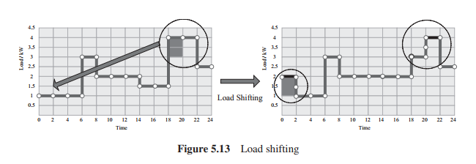
Load Shifting
In Figure 5.13, a load such as a wet appliance (washing machine) that consumes 1 kW for 2 hours is shifted to off-peak time.

Slide 32
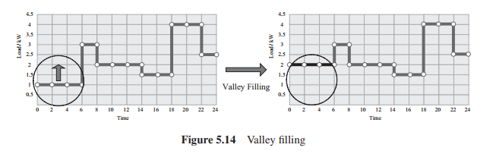
Figure 5.14 shows the main purpose of valley filling, which is to increase off-peak demand through storing energy, for example, in a battery of a plug-in electric vehicle or thermal storage in an electric storage heater. The main difference between valley filling and load shifting is that valley filling introduces new loads to off-peak time periods, but load shifting only shifts loads so the total energy consumption is unchanged

Slide 33
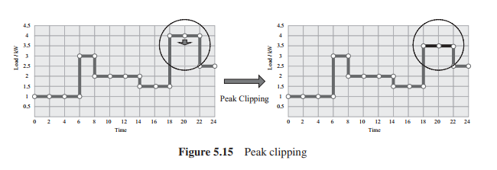
Peak clipping reduces the peak load demand, especially when demand approaches the thermal limits of feeders/transformers, or the supply limits of the whole system. Peak clipping (Figure 5.15) is primarily done through direct load control of domestic appliances, for example, reducing thermostat setting of space heaters or control of electric water heaters or air-conditioning units.

Slide 34
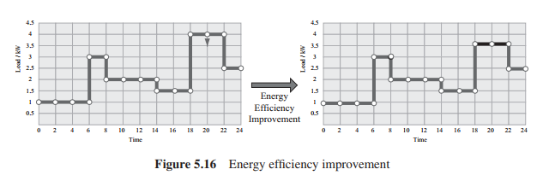
Figure 5.16 shows the reduction in energy demand when ten 60 W filament lamps (operating from 18.00 hrs to 22.00 hrs) are replaced by 20 W Compact fluorescent lamps.

Slide 35
With the deployment of smart metering and the development of home area automaton technologies, domestic appliances can be controlled in a more intelligent way, therefore bringing more flexibility to the demand side.
The load shape is then flexible and can be controlled to meet the system needs. However, for the most effective DSI, the utility needs to know not only which loads are installed in the premises but which are in use. In this case two-way communication between the smart meter and network operators is necessary

Slide 36
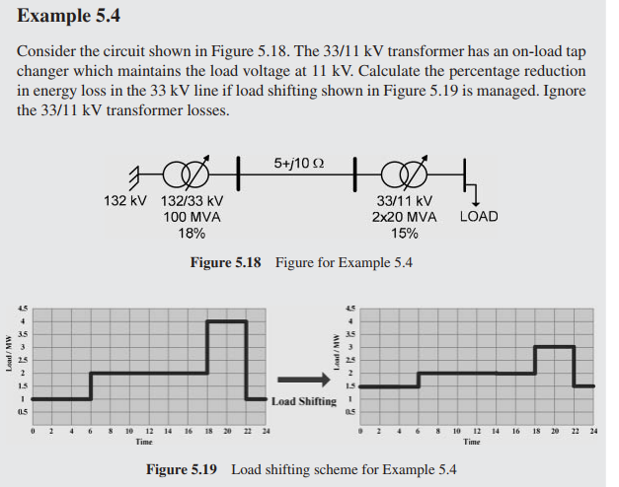

Slide 37
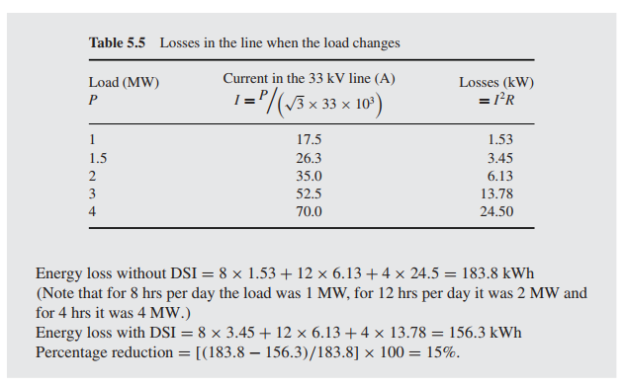

Slide 38
Implementations of DSI
The implementations of DSI can be through price-based schemes or incentive-based schemes. Price-based DSI encourages customer load changes in response to changes in the electricity price

Slide 39
Price-based DSI implementations
Tariffs and pricing can be effective mechanisms to influence customer behaviour, especially in unbundled electricity markets. Price schemes employed include time of use rates, real-time pricing and critical peak pricing

Slide 40
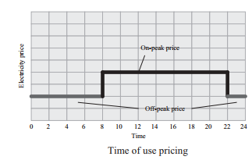
Time of use (ToU): ToU rates use different unit prices for different time blocks, usually pre-defined for a 24-hour day. ToU rates reflect the cost of generating and delivering power during different time periods.

Slide 41
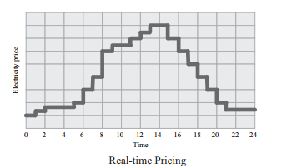
Real-time pricing (RTP): the electricity price provided by RTP rates typically fluctuates hourly, reflecting changes in the wholesale electricity price. Customers are normally notified of RTP prices on a day-ahead or hour-ahead basis.

Slide 42
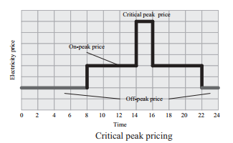
Critical peak pricing (CPP): CPP rates are a hybrid design of the ToU and RTP. The basic rate structure is ToU. However, the normal peak price is replaced by a much higher CPP event price under predefined trigger conditions (for example, when system is suffering from some operational problem or the supply price is very high).

Slide 43
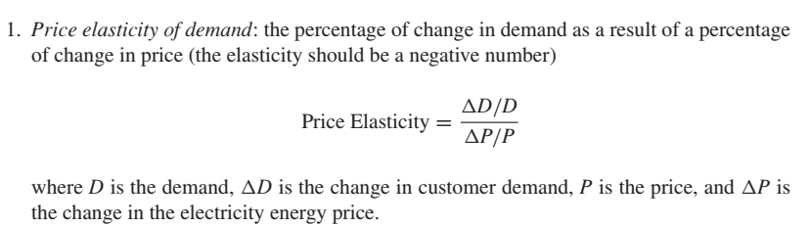

Slide 45
Hardware support to DSI implementations
The essential ICT infrastructure required for DSI can be provided by smart metering. In addition, load control switches, controllable thermostats, lighting controls and adjustable speed drives are required. Such equipment receives signals such as alarms or price signals and controls loads accordingly

Slide 46
Load control switches
A load control switch is an electronic apparatus which consists of a communication module and a relay. It is wired into the control circuit of an air conditioning system, a water heater or a piece of thermal comfort equipment. The communication module is used to receive control signals from the DSI program operator (or a HAN). The time that the appliance will remain disconnected is generally pre-programmed (through an inbuilt clock).

Slide 47
Controllable thermostats
This type of apparatus combines a communication module with a controllable thermostat, and replaces conventional thermostats such as those on air conditioning systems or water heaters.
The DSI program operator (or a HAN) can increase or decrease the temperature set point through the communication module, changing the functioning of the equipment and hence the electricity load

Slide 48
Lighting control
Lighting control equipment is used to manage the energy used by lighting in a more efficient way. Lighting control strategies for energy consumption reduction are listed in Table 5.7.
Estimated energy savings are presented for each case. These savings are based upon estimated average consumption, the time of use and user behavior.

Slide 49
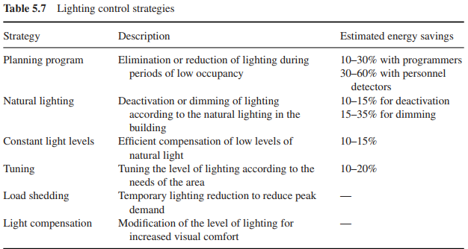

Slide 50
Adjustable speed drives
Adjustable Speed Drives (ASDs) allow electric motors driving pumps, ventilation units and compressors to function over a continuous speed range. The loads of the majority of motorized appliances change over time and equipment is often operated at less than full load. ASDs allow the motors to satisfy the required functioning conditions and to economise power and energy use when the system is not functioning at its maximum load. Directly connected motors for pump and fans are often oversized and the fluid flow throttled for control. Replacement of this system by an ASD can yield considerable saving of energy.

Slide 51
Flexibility delivered by prosumers from the demand side
Some customers have installed Distributed Generation (DG) and energy storage (these are generally referred to Distributed Energy Resources – DERs) in their premises. Such customers not only consume electricity, but also are able to manage their capacity to supply power to the grid. Hence they are also called prosumers. The controllability of active power is fundamental for the commercial integration of prosumers. The controllability of reactive power of distributed energy resources has a great influence on the fault ride-through capability and the provision of ancillary services.

Slide 52
System support from DSI
Emergency load shedding has been used in many power systems to maintain the integrity of the power system in the event of a major disturbance. It is triggered by under-frequency relays when the frequency drops under a certain threshold, for example, 48.8 Hz in England and Wales, and consists of the tripping of entire distribution feeders. Load shedding is planned by the TSO but is implemented by the DNOs who arrange the tripping of distribution feeders and choose which feeders are tripped.

Slide 53
During normal operation, the GB Transmission System Operator (NGET) maintains the frequency at 50 ± 0.2 Hz. In order to maintain frequency, NGET buys frequency response services. When the frequency goes up, high frequency response is used to reduce the power output of the large generators and hence the frequency. A sudden drop in frequency is contained using primary response (Figure 5.22). This should be delivered within 10 seconds and maintained for another 20 seconds [15]. The system frequency is brought back to normal using secondary response which lasts from 30 seconds to 30 minutes. If the frequency continues to drop below 48.8 Hz, demand is disconnected (load shedding) to prevent shutdown of the power system

Slide 54
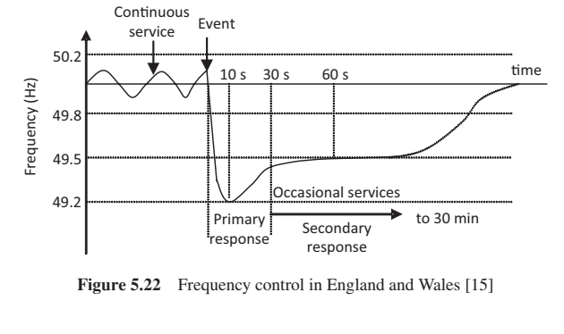

Slide 55
Hybrid Energy Scheduling of Micro Smart house Composed of
➢Fuel Cell (FC)
➢Electric Vehicle (EV)
➢Auxiliary Boiler
➢Battery Energy Storage System (BESS)

Slide 56
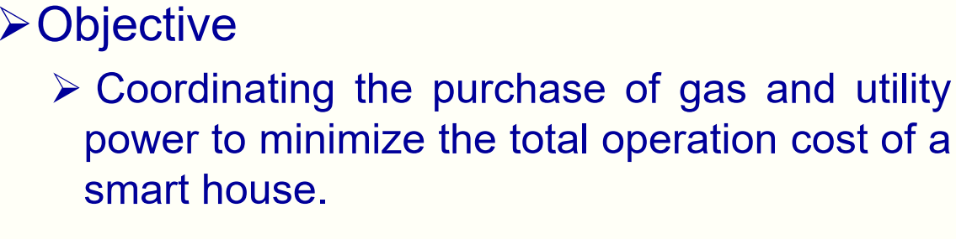

Slide 57
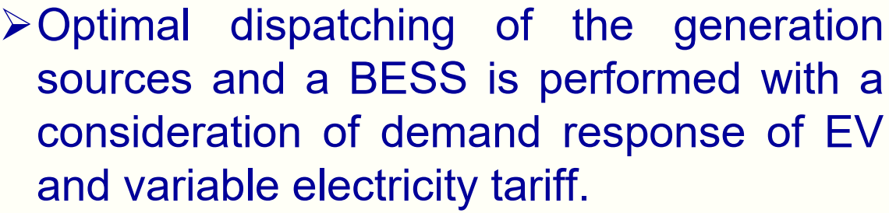

Slide 58
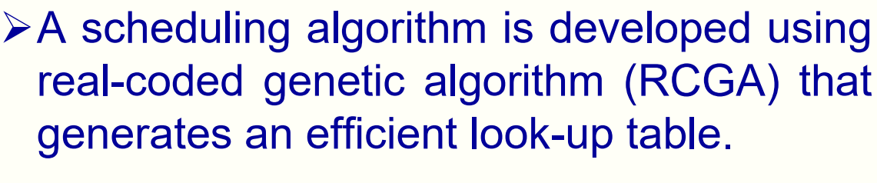
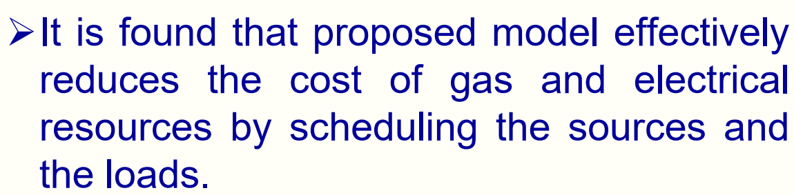

Slide 59
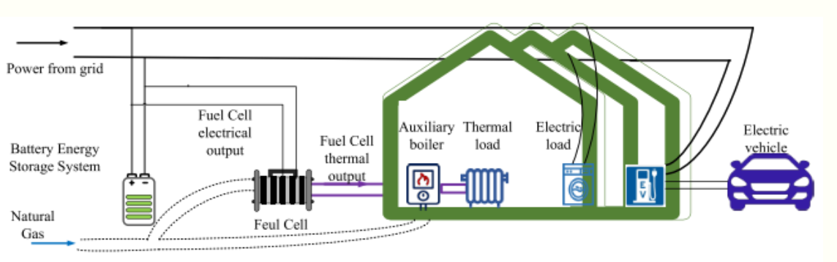

Slide 60
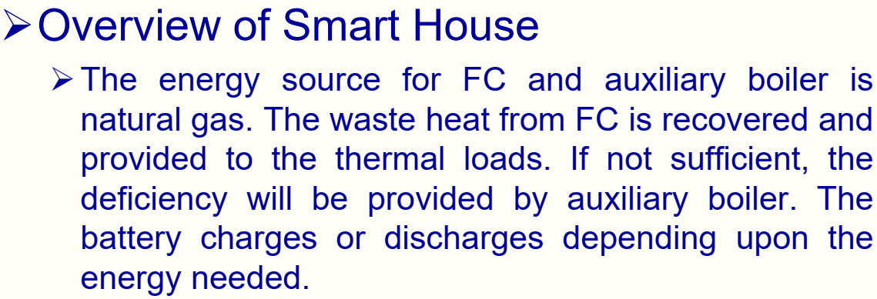

Slide 61
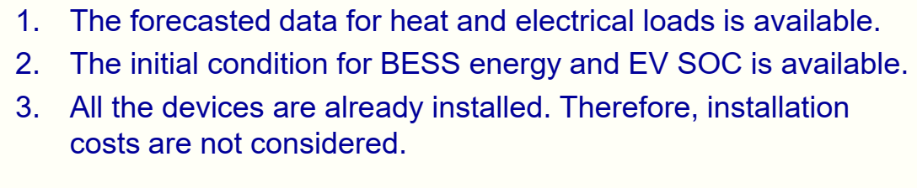

Slide 62
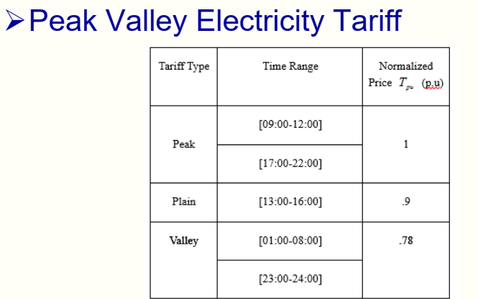

Slide 63
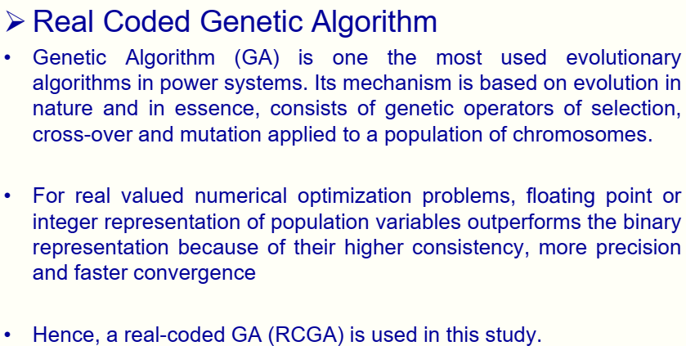

Slide 64
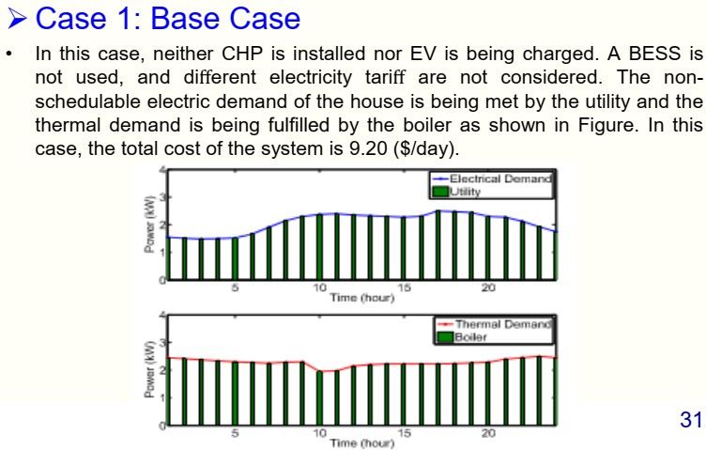

Slide 65
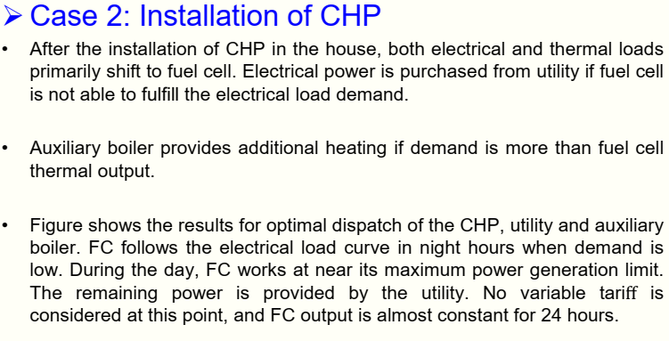

Slide 66
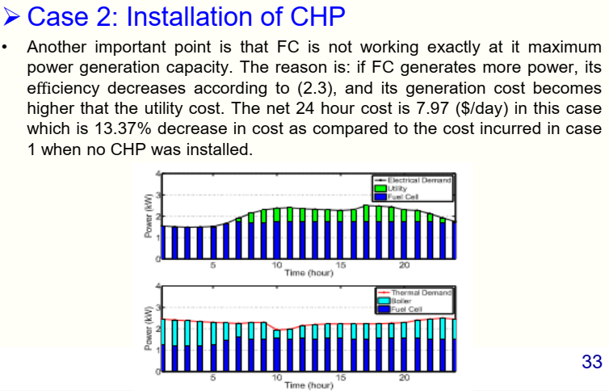

Slide 67
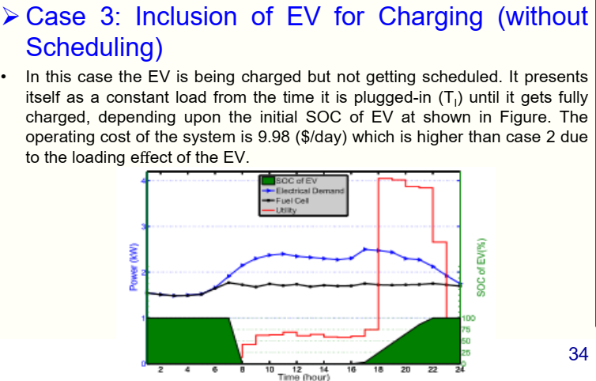

Slide 68
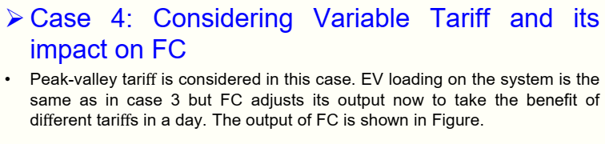

Slide 69
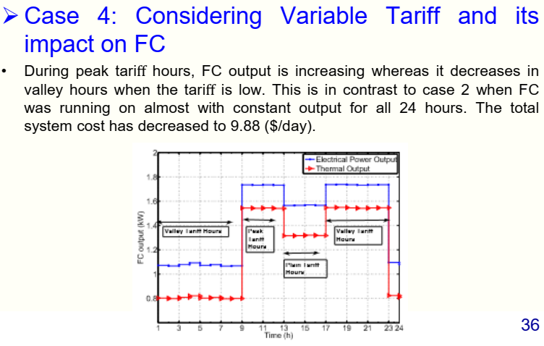

Slide 70
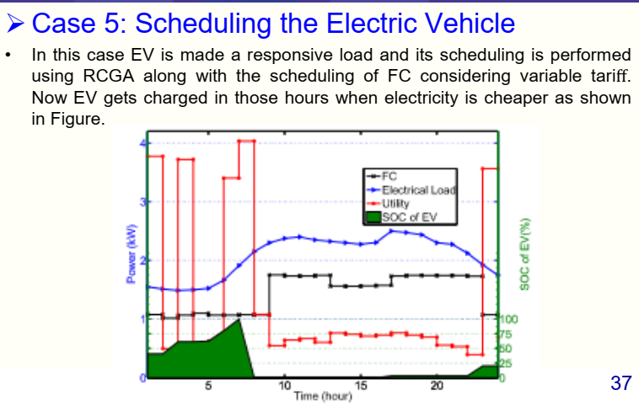

Slide 71
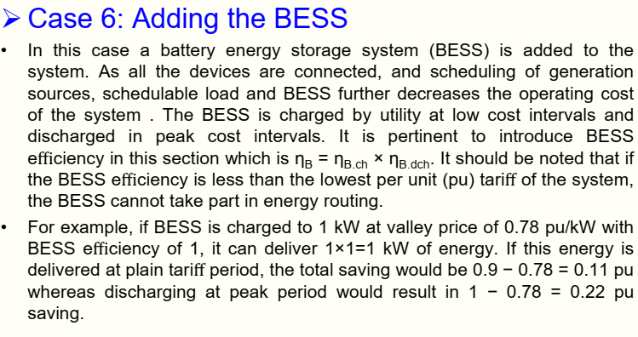

Slide 72
